Slide 1

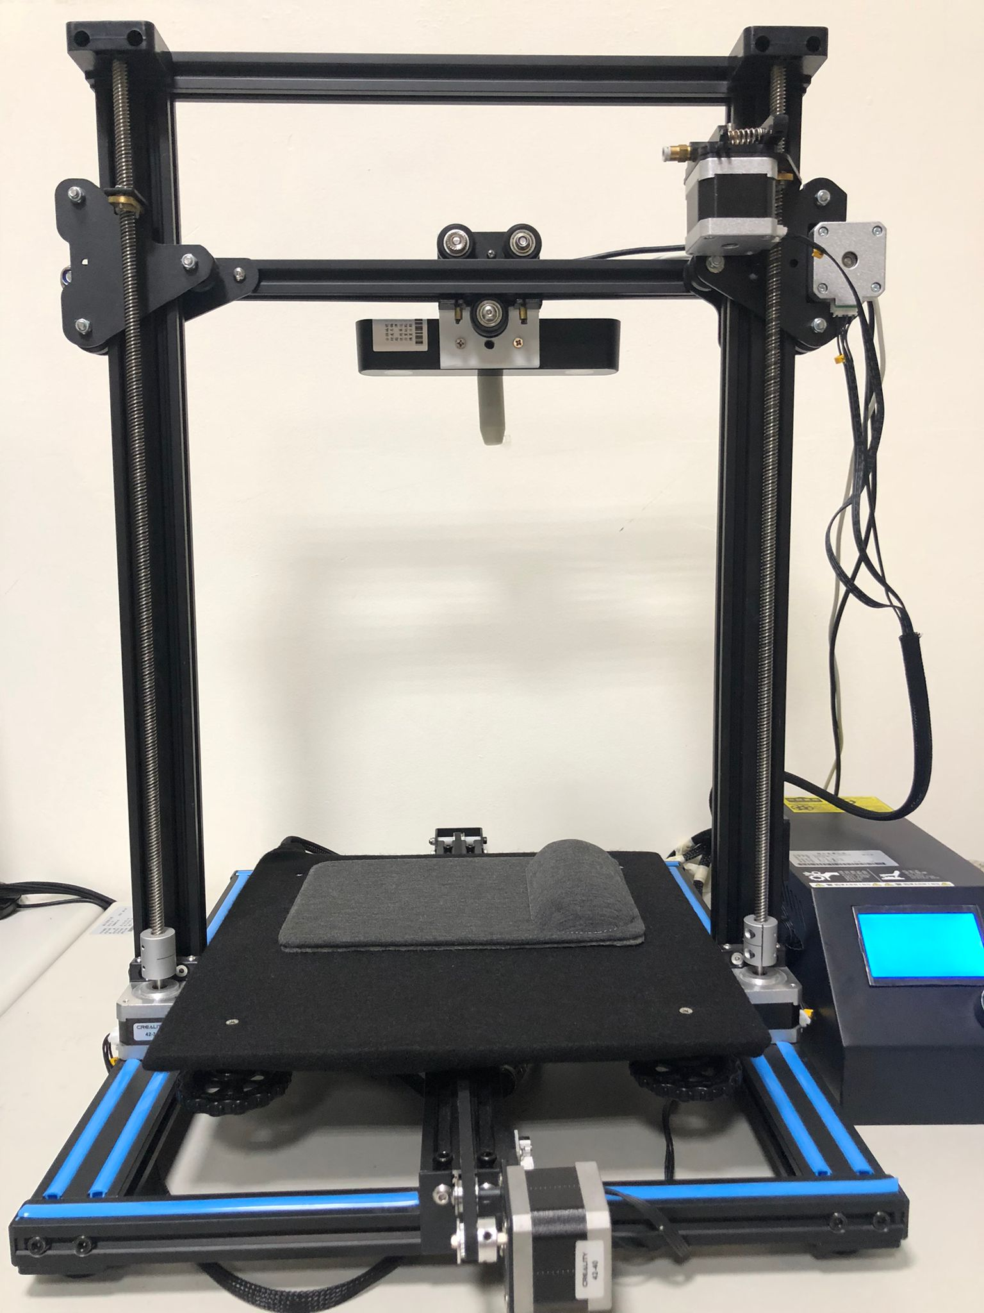
Automated Pulse Sensing Tool
Tyler Eck - 410821337
NDHU Undergraduate Project
Advisor: 顏士淨 (Shi-Jim Yen)

Slide 2
Agenda
Introduction
Motive
Implementation
Program Execution
Research Results
Conclusion

Slide 3
Introduction

Slide 4
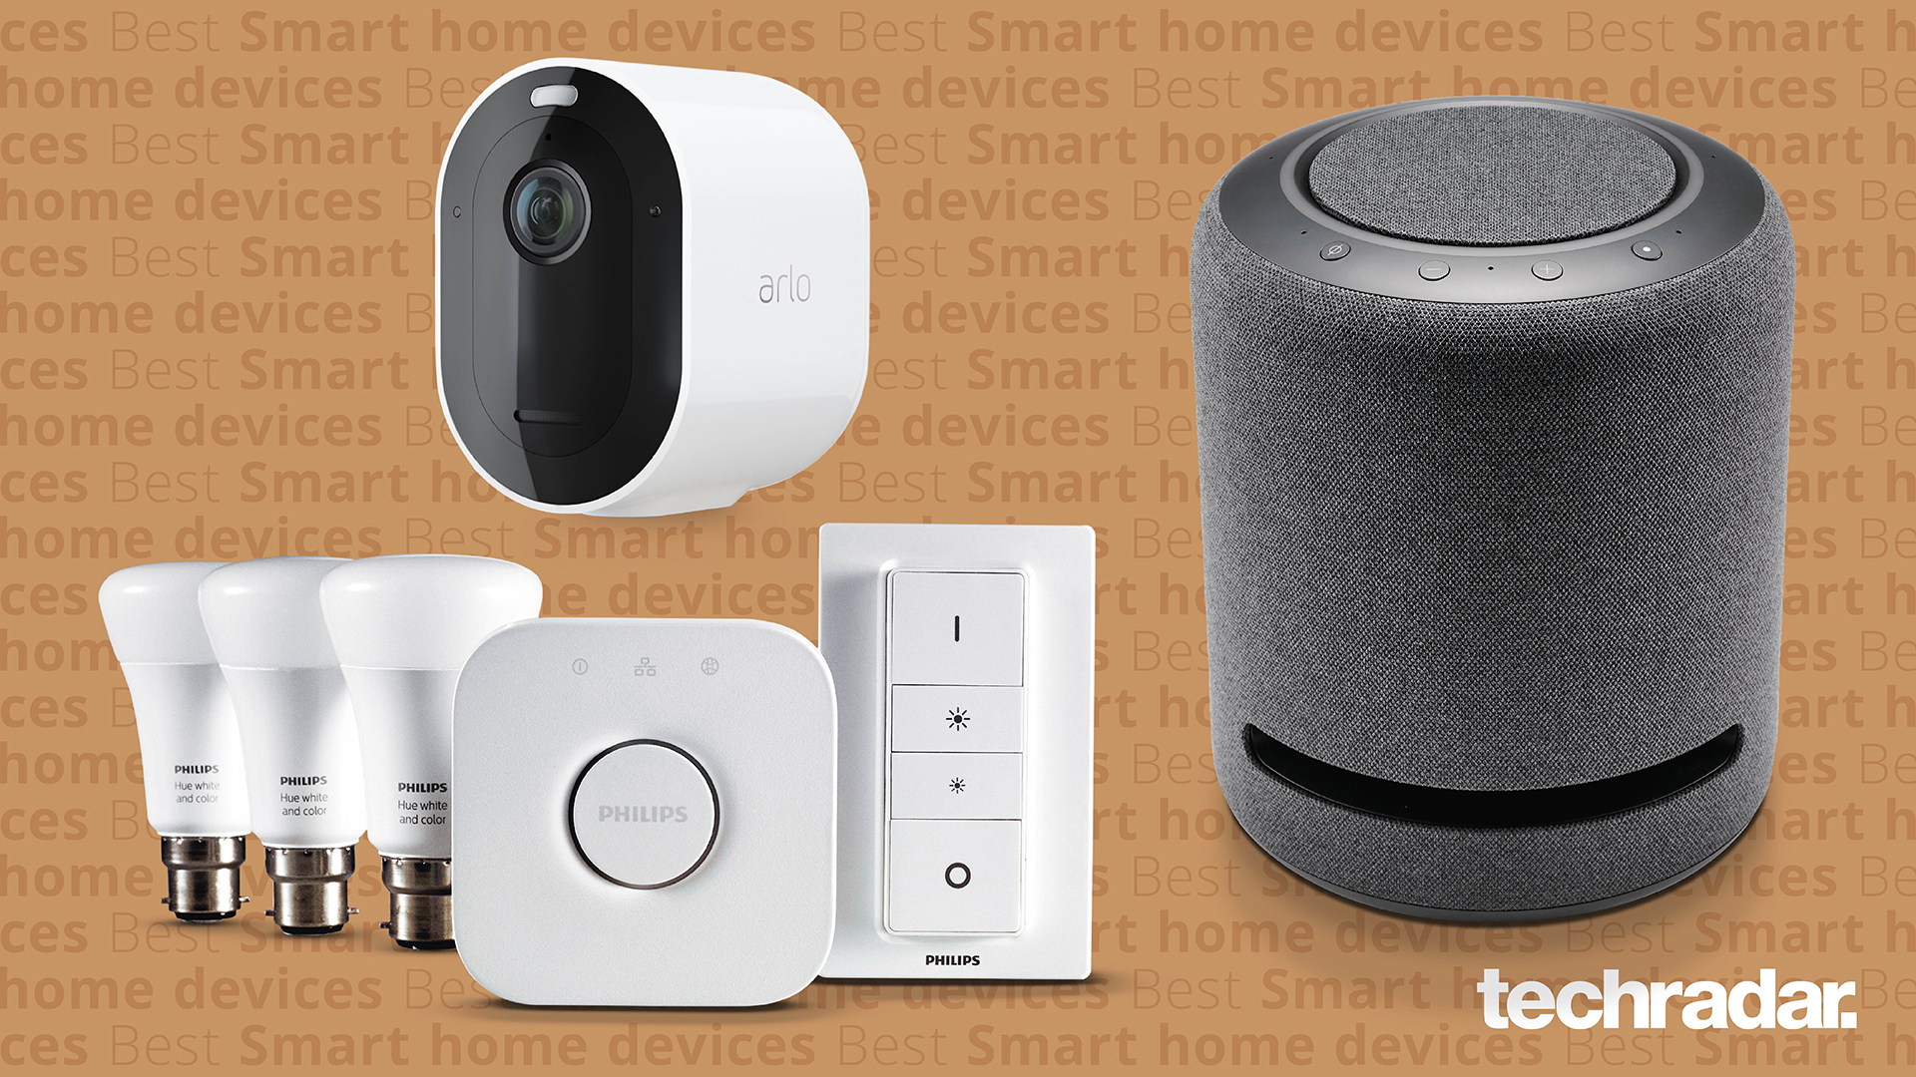
Automation
Automation technology is slowly creeping into our lives

Slide 5

Tesla: Autonomous Vehicle

Slide 6
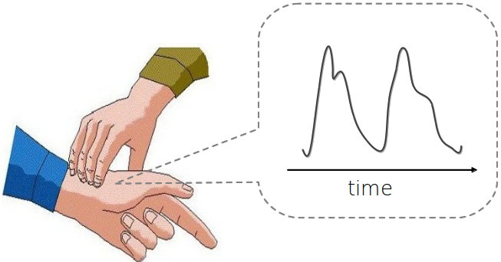
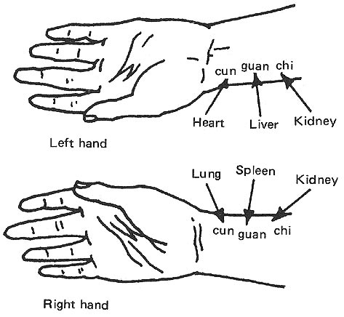
Traditional Chinese Medicine: Pulse Diagnosis
Apply automation to a medical procedure
One of the four main assessments in TCM consultation
Cun, Guan, Chi – 3 pulse points on the wrist
Still popular to this day

Slide 7
Objective/Goal:
Automated Pulse Sensing Tool
+
TCM Pulse Diagnosis
=
Automation
To design and implement an automated pulse sensing tool that will allow for users to measure their pulse with ease

Slide 8
Motive

Slide 9





1. Increase Connectivity
Social Networks
Remote Conferencing

Slide 10
2. Ease of Access for Patient
Elderly population in Eastern Taiwan living in remote areas
Proposed tool allows for convenience – making it more accessible for these people to consult a doctor

Slide 11
Implementation

Slide 12
Automated Pulse Sensing Tool
Hardware
Software
X,Y,Z Motors
Camera
Pulse Sensor
Main GUI
Arduino Control
Detection Algorithm
Firebase Configuration

Slide 13
Hardware

Slide 14
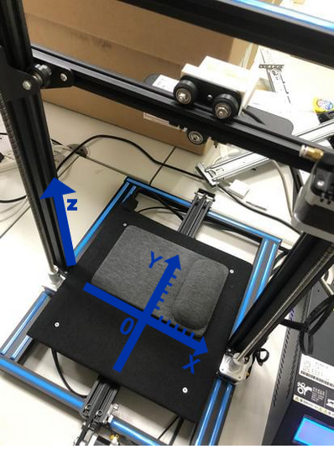
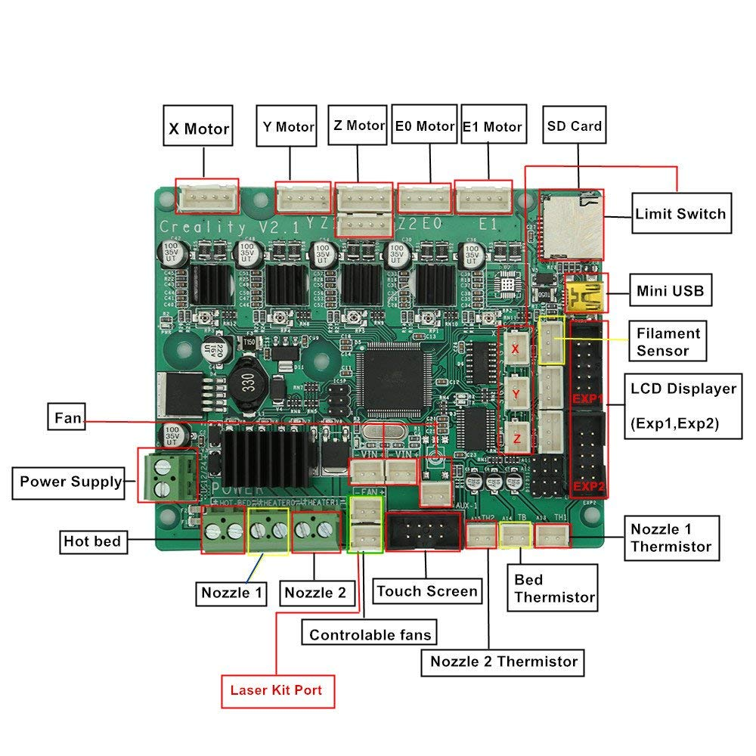
1.) Creality 3D printer
Main Base
X,Y,Z Step Motors & Stop Switches
Controlled By Arduino 2560
motherboard

Slide 15
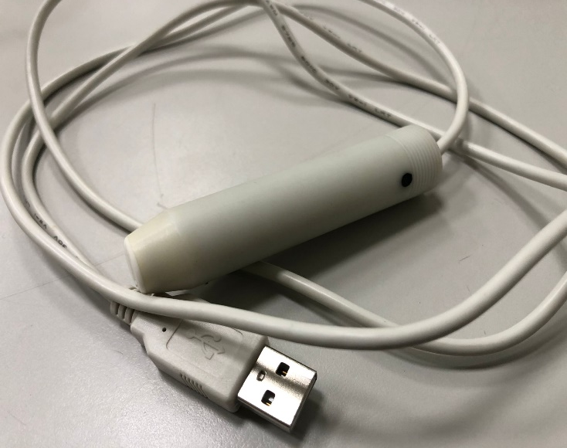

2.) Pulse Sensor and Camera
HK-2019 Cylindrical Pulse Sensor
- 200 Hz - Pulse and Pressure
StereoLabs ZED Dual Camera
- High frame rate and depth
perception.

Slide 16
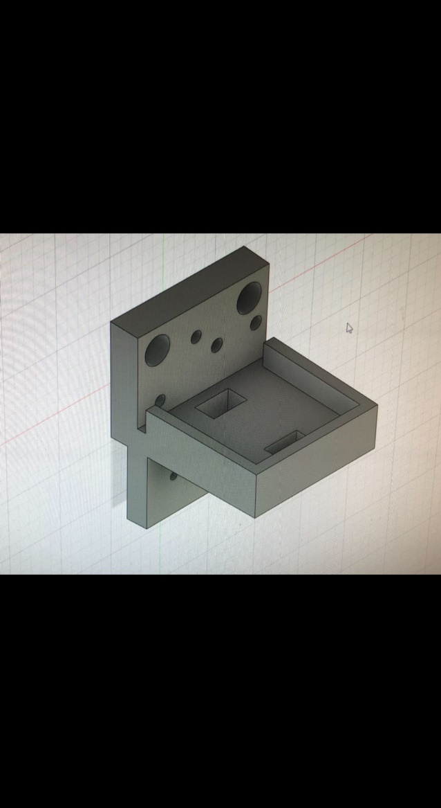
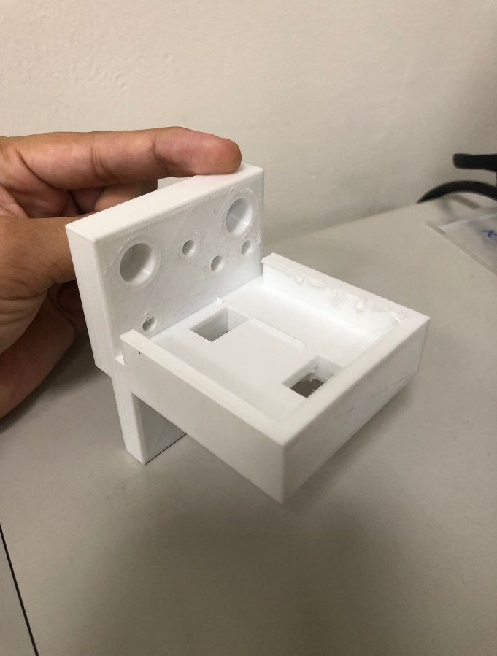
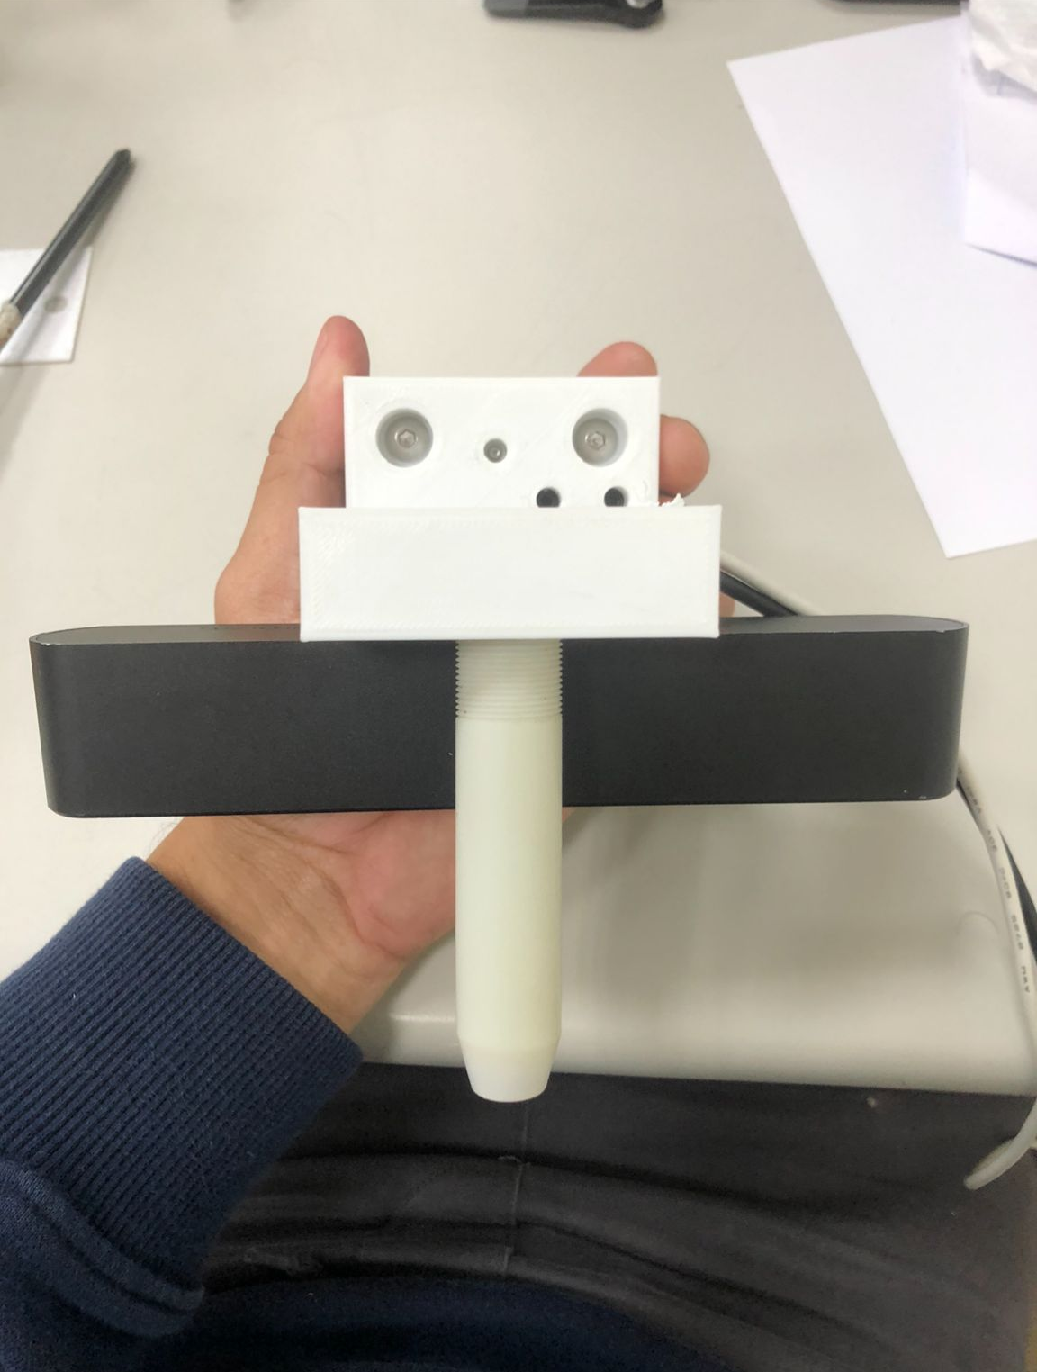
3.) Pulse Sensor/Camera Hold
To mount both Pulse Sensor and Camera, a specially designed 3D-printed piece was needed.

Slide 17

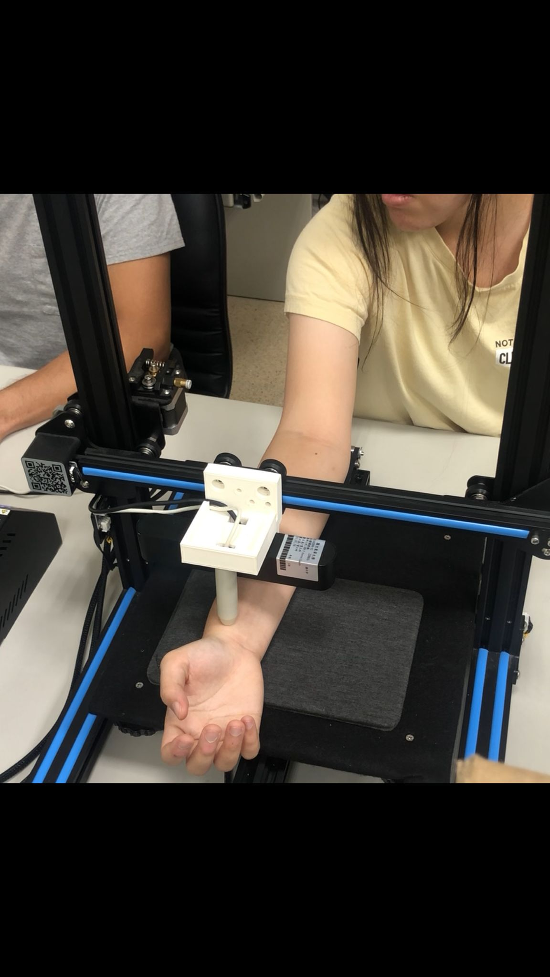
Completed Hardware

Slide 18
Software

Slide 19
Plan for product launch
Deploy strategic networks with compelling e-business needs
Planning
Marketing
Disseminate standardized metrics
Design
Coordinate
Foster holistically superior methodologies
Launch
Strategy
e-business applications
Synergize scalable e-commerce
1
2
3
4
5

Slide 20
Timeline
Deploy strategic networks with compelling e-business needs
Sep 20XX
Synergize scalable e-commerce
Nov 20XX
Disseminate standardized metrics
Jan 20XX
Coordinate e-business applications
March 20XX
Foster holistically superior methodologies
May 20XX

Slide 21
Areas of focus
B2B market scenarios
Cloud-based opportunities
Develop winning strategies to keep ahead of the competition
Capitalize on low-hanging fruit to identify a ballpark value
Visualize customer directed convergence
Iterative approaches to corporate strategy
Establish a management framework from the inside

Slide 22
How we get there
ROI
Niche Markets
Supply chains
Envision multimedia-based expertise and cross-media growth strategies
Visualize quality intellectual capital
Engage worldwide methodologies with web-enabled technologies
Pursue scalable customer service through sustainable strategies
Engage top-line web services with cutting-edge deliverables
Cultivate one-to-one customer service with robust ideas
Maximize timely deliverables for real-time schemas

Slide 23
Summary
At Contoso, we believe in giving 110%. By using our next-generation data architecture, we help organizations virtually manage agile workflows. We thrive because of our market knowledge and great team behind our product. As our CEO says, "Efficiencies will come from proactively transforming how we do business."

Slide 24
Thank you
Mirjam Nilsson​
mirjam@contoso.com
www.contoso.com

